Slide 1
SPEECH EMOTION RECOGNITON
Zeel Tanna
209309048
DSE - A

Slide 2
Index
01. Introduction
02. Literature Review
03. Design & Implementation
04. LSTM Model
05. Results

Slide 3

Introduction
Speech Emotion Recognition deals with the part of research wherein the machines are able to detect, decode and reorganize emotions and lexical content from speech.
Speech Emotion Recognition System has a three-layered architectural approach:
Speech Processing System
Feature Extractor
Classifier

Slide 4
LITERATURE REVIEW
Motivation
Human speech is highly complex due to the fact that vocal expressions are evolving right as we speak. The database is so extensive that the machine many times fails to identify the correct characteristics of the vocal expressions hence this field needs to be worked upon consistently.
Project
My Project deals with SER and its analysis. Programming language used is Python. Data Set used is downloaded from Kaggle(Toronto Emotion Speech Set).
The data set comprises of target words spoken by two actresses, portraying seven different emotions. There are 5600 audio files in total in the format of WAV.

Slide 5

Design & Implementation

Slide 6
DESIGN
Neural Networks
Recurrent Neural Network
The concept of neural networks was put into use for recognition of the vocal expressions. Since they work the same way human brains do they interpret, decode and adapt to produce the best possible desired outcome.
There are various types of Neural Networks, but I chose to use recurrent neural networks since they are the best fit for the data set.
RNN is used for Speech Recognition, Voice Recognition, Natural Language processing etc.
The model for training and testing used is the LSTM model. It is special kind of RNN that is capable of learning long dependencies thus solving vanishing gradient problems.

Slide 7
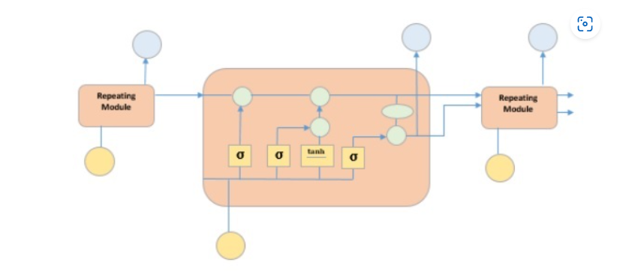
LSTM MODEL
Figure shows the four neural network layers in yellow boxes.
Point wise operators are in green circles
Input is present in the yellow circles
Point wise operators in blue circles

Slide 8
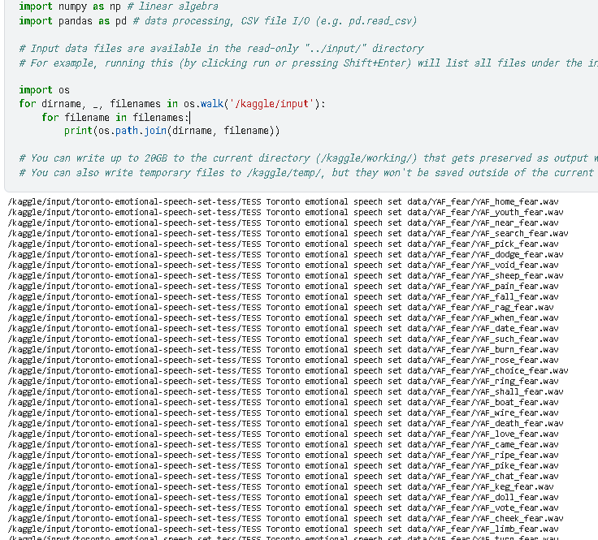
I. Loading Data Set
The TESS dataset used for preprocessing contains 2800 data records for the following seven emotions: (anger, disgust, fear, happiness, pleasant surprise, sadness and neutral).

Slide 9
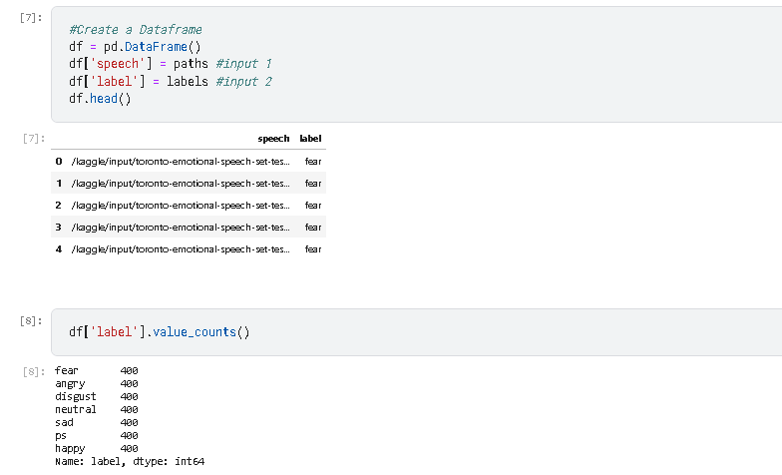
The first step is to trim down the filenames of the files to just emotion.wav format
This is done to simplify the filenames for preprocessing.
These files are stored inside two variables; paths[ ] and labels [ ]
These files are then entered into a new Dataframe for processing

Slide 10
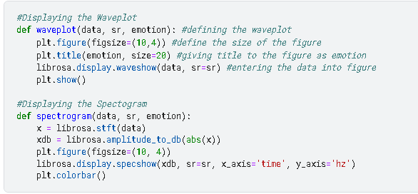
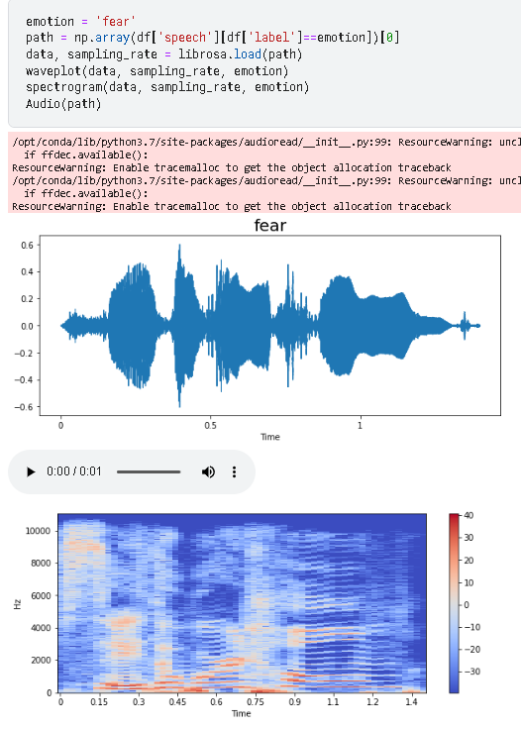
II. Exploratory Data Analysis
Using the Waveplot function to plot the varying amplitudes of the audio dataset and defining the display parameters
Using the Spectrogram function to display the signal strength of the loudness of the audio data over time at various frequencies.

Slide 11

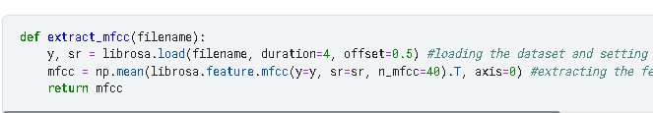
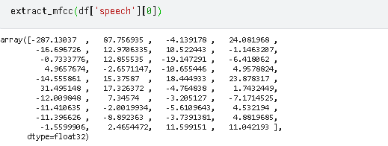
III. Feature Extraction
Extraction of features is a very important part in analyzing and finding relations.
The data provided of audio cannot be understood by models directly since and thus we convert it into more understandable form.
Audio is a three-dimensional signal which is converted into one-dimensional array

Slide 12
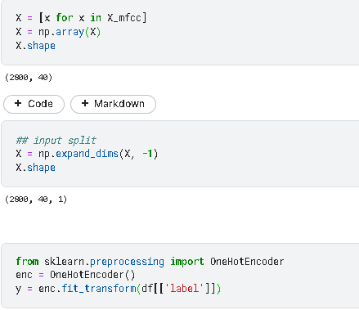
We then split the input data set and inset it into a new array for encoding.
Then the audio data in the array is converted into vector form using OneHotEncoder function.

Slide 13
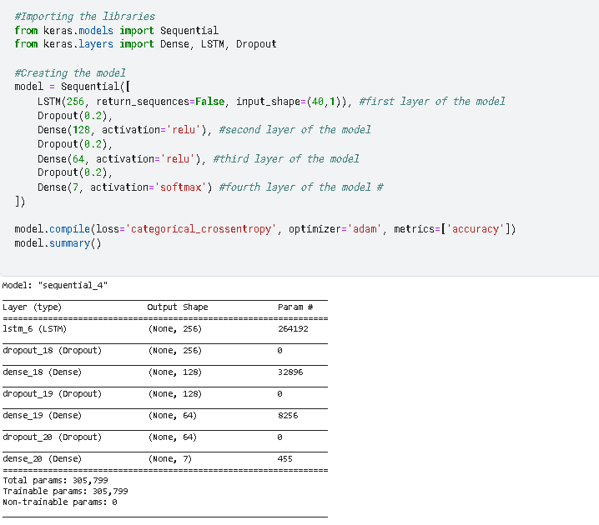
IV. LSTM Model
The LSTM model is modified version of the RNN.
LSTM model is preferred over RNN here since it removes the vanishing gradient problem that occurs in RNN.
My model contains four neural network layers:
The first layer is the LSTM layer itself
The Second layer consists of RELU activation function
The Third layer consists of RELU function as well
The Fourth Layer uses the SOFTMAX function

Slide 14
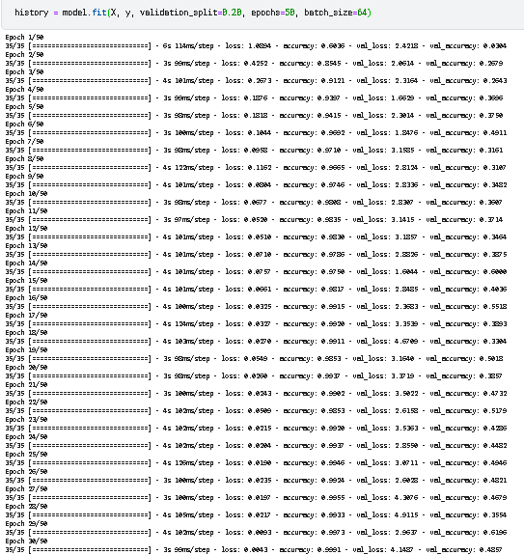
Running the model using the input dataset and setting the Epoch value to 50.
We get highest accuracy of 61.96% in epoch 29

Slide 15
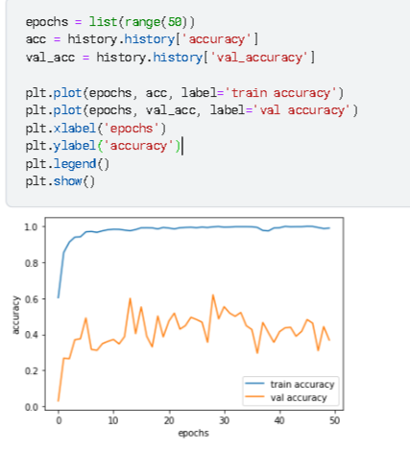
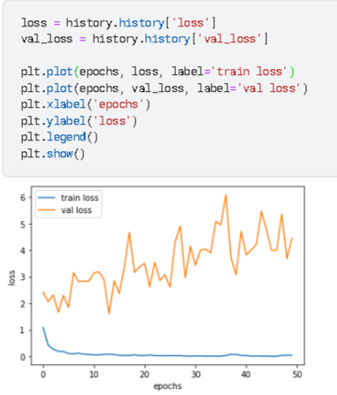
Results
We plot the results of the model in Value Accuracy graph where x axis = epochs and, y axis = accuracy
We plot the results of the model in Value Loss graph where x axis = epochs and y axis = loss

Slide 16

Thank you

